Slide 1
DESIGNING GUI FOR NUMERICAL METHODS IN MATLAB
GROUP 13

Slide 2
INTRODUCTION
A GUI is an interface for user interaction with software combining usability,and accessibility.
The purpose of the project is to design a GUI to simplify solving numerical methods computability .
The numerical methods covered are;
Newton rapshon method
Secant method
Bisection method
Fixed point iteration
Euler
Runge kutta 4
Simpson

Slide 3
METHODOLOGY USED
Work was divided among group members and specific steps were followed
Steps followed:
Open MATLAB and create script
Develop numerical method class codes
Design GUI code
Test and run GUI with different numerical methods

Slide 4
GUI Components
Drop-down menus to select problem type and method.
Numeric input fields: Lower Limit, Upper Limit, Step Size, Initial Condition.
Compute Button to run calculations.
Text area for results display.
Plot area (UIAxes) for graphical visualization.
GUI Features and Workflow
Consistent layout and color scheme ensures ease of use.
Real-time plotting of results for visual understanding.
Feedback through result display and computation time shown.
Accessible input validation and error handling

Slide 5
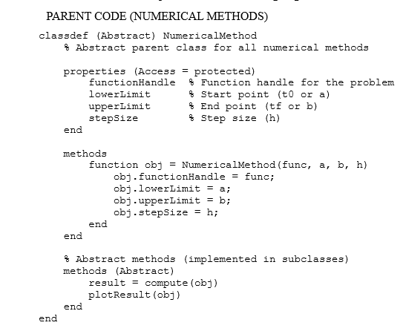
THE WORK FLOW
Different codes combining the concept of classes, encapsulation, inheritance, polymorphism and abstraction were developed and used in the designing of the numerical methods GUI as shown below.
For example

Slide 6
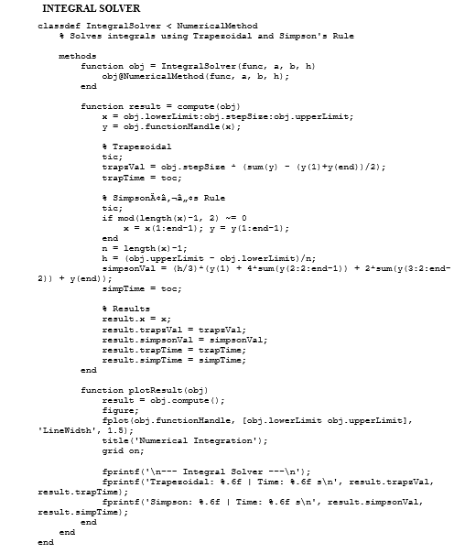
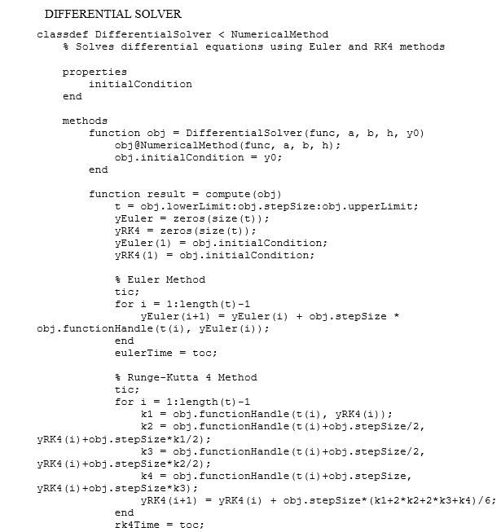

Slide 7
DEVELOPING THE NUMERICAL METHODS GUI
We built a modular MATLAB GUI that runs multiple numerical methods (root finding, ODE solving, and integral solving) via a single interface.
We added parameters for input, method selection, run, and view results and plots.
Also added Dropdowns; to select the Problem type (Differential, Integral, Root Finding) and Method (Newton-Raphson, Euler, RK4, Trapezoidal, Simpson, etc.
Used input numeric fields for; Lower limit a, Upper limit b, Step size h, Initial condition y0 (for ODEs), Initial guess x0 (for roots)
Compute button that Executes the chosen method with current inputs
Used a Text area for outputting results/timing;
Added UIAxes for plots Callback basics

Slide 8
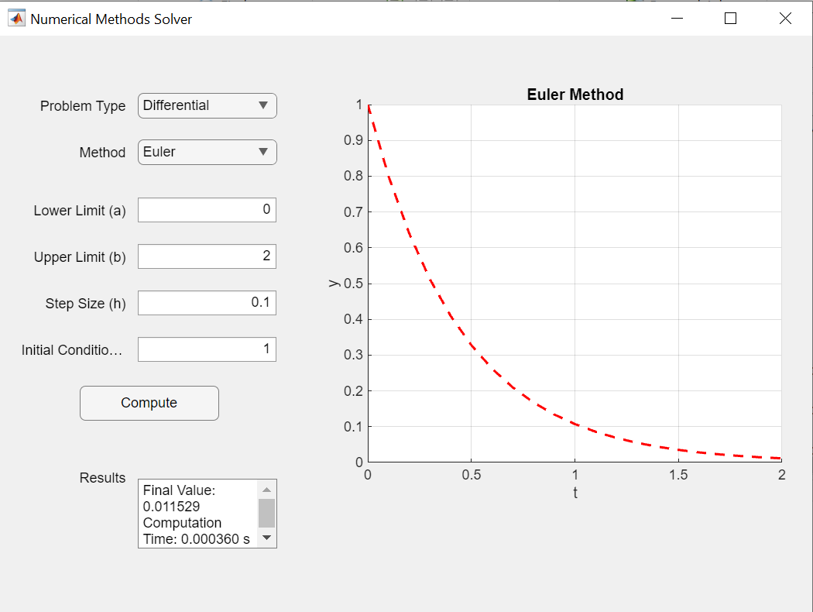
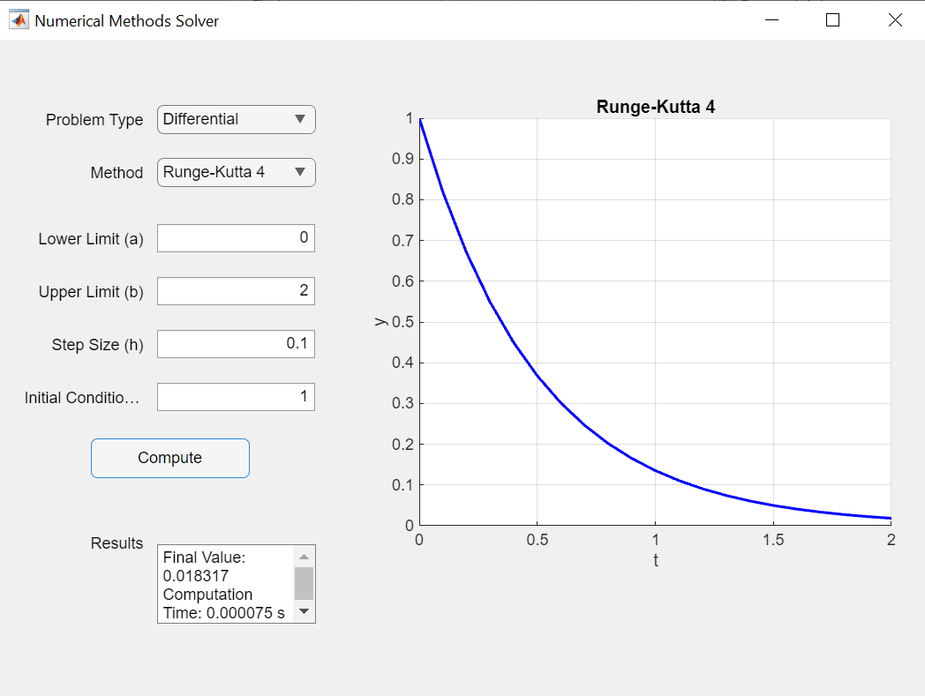
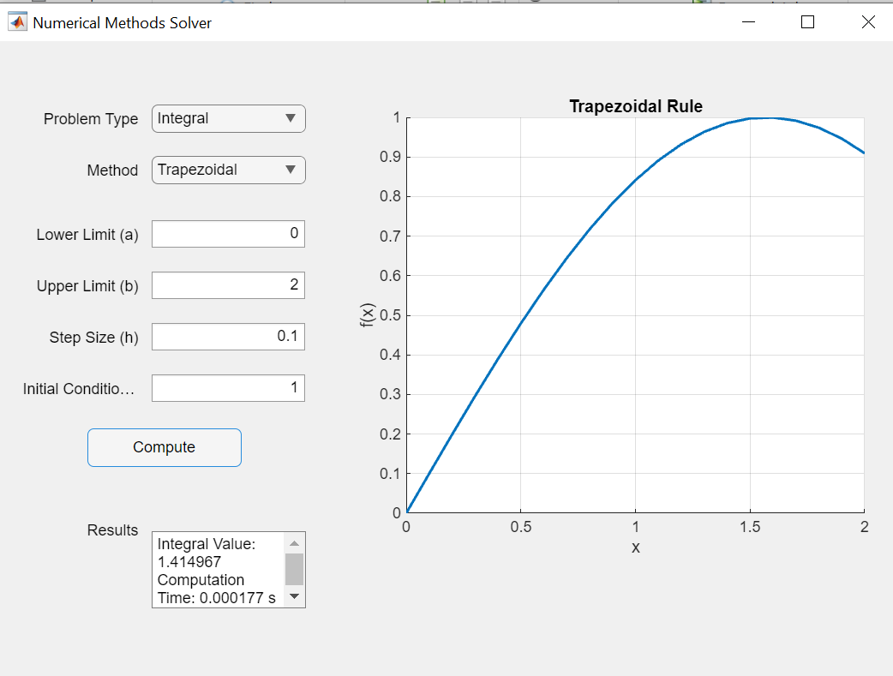
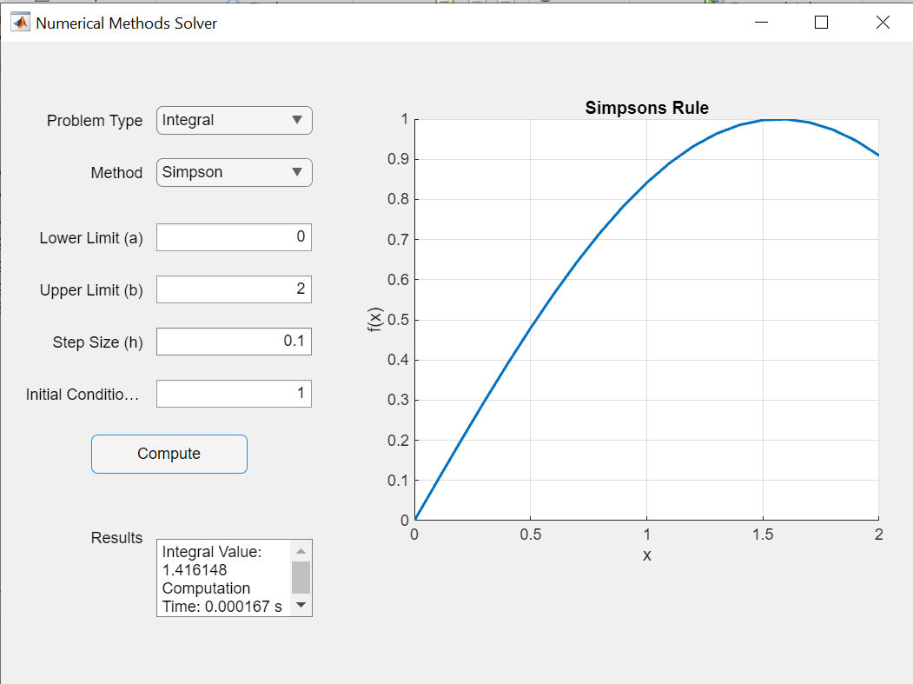
THE GUI OUTPUT

Slide 9
RECOMMENDATION
Prioritize usability and user-centric approaches.
Maintain consistency in design elements.
Ensure responsiveness and accessibility.
Implement feedback mechanisms for user actions.
Conduct regular user testing and adapt to evolving standards.

Slide 10
CONCLUSION
Effective GUI design enhances computational problem-solving.
MATLAB provides a powerful environment for GUI and numerical methods integration, Continuous improvement and adherence to design principles vital.

